Slide 1
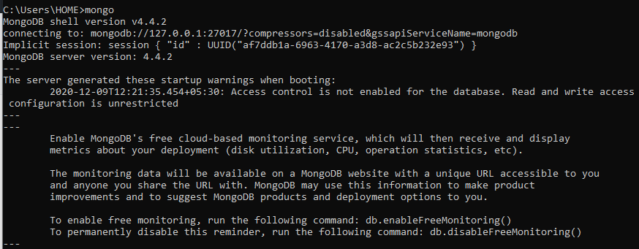
MongoDB version

Slide 2

Showing the databases and using

Slide 3

Displaying the data

Slide 4
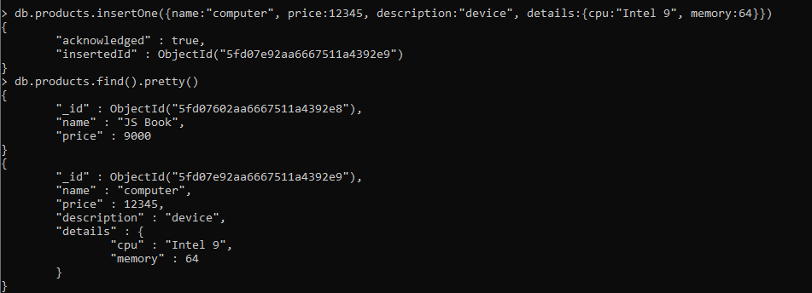
Inserting data into db and displaying

Slide 5
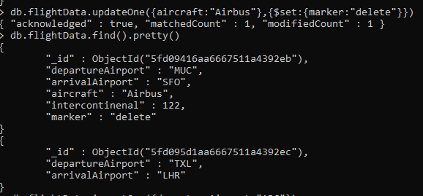
Updating the db and displaying

Slide 6

Finding the docs by fileds

Slide 7

Using atomic operator

Slide 8
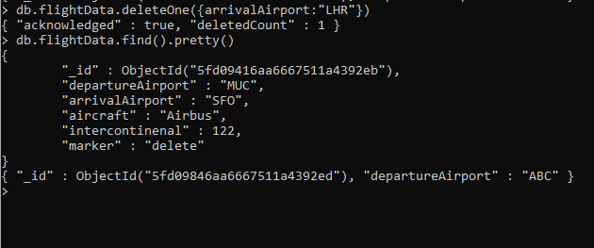
Deleting filed from db

Slide 9
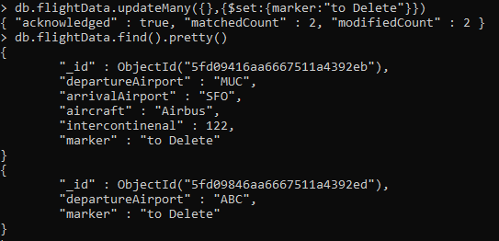
Updating many docs

Slide 10
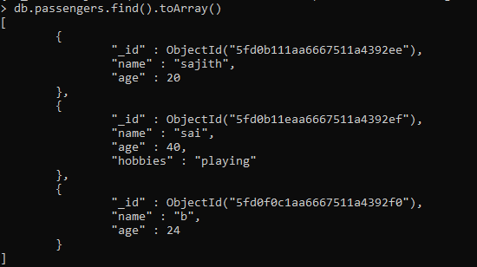
Using toArray()

Slide 11
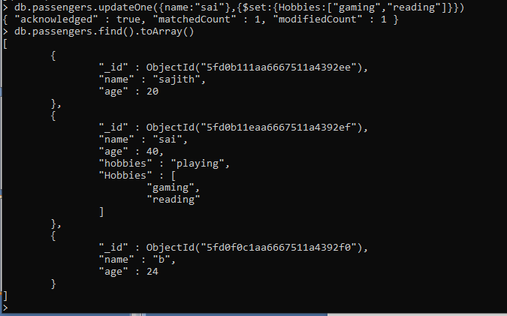
Updating hobbies based on name

